Slide 1
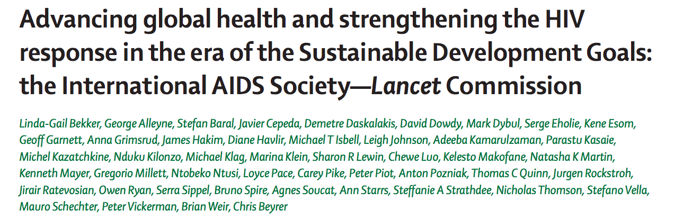

Slide 2
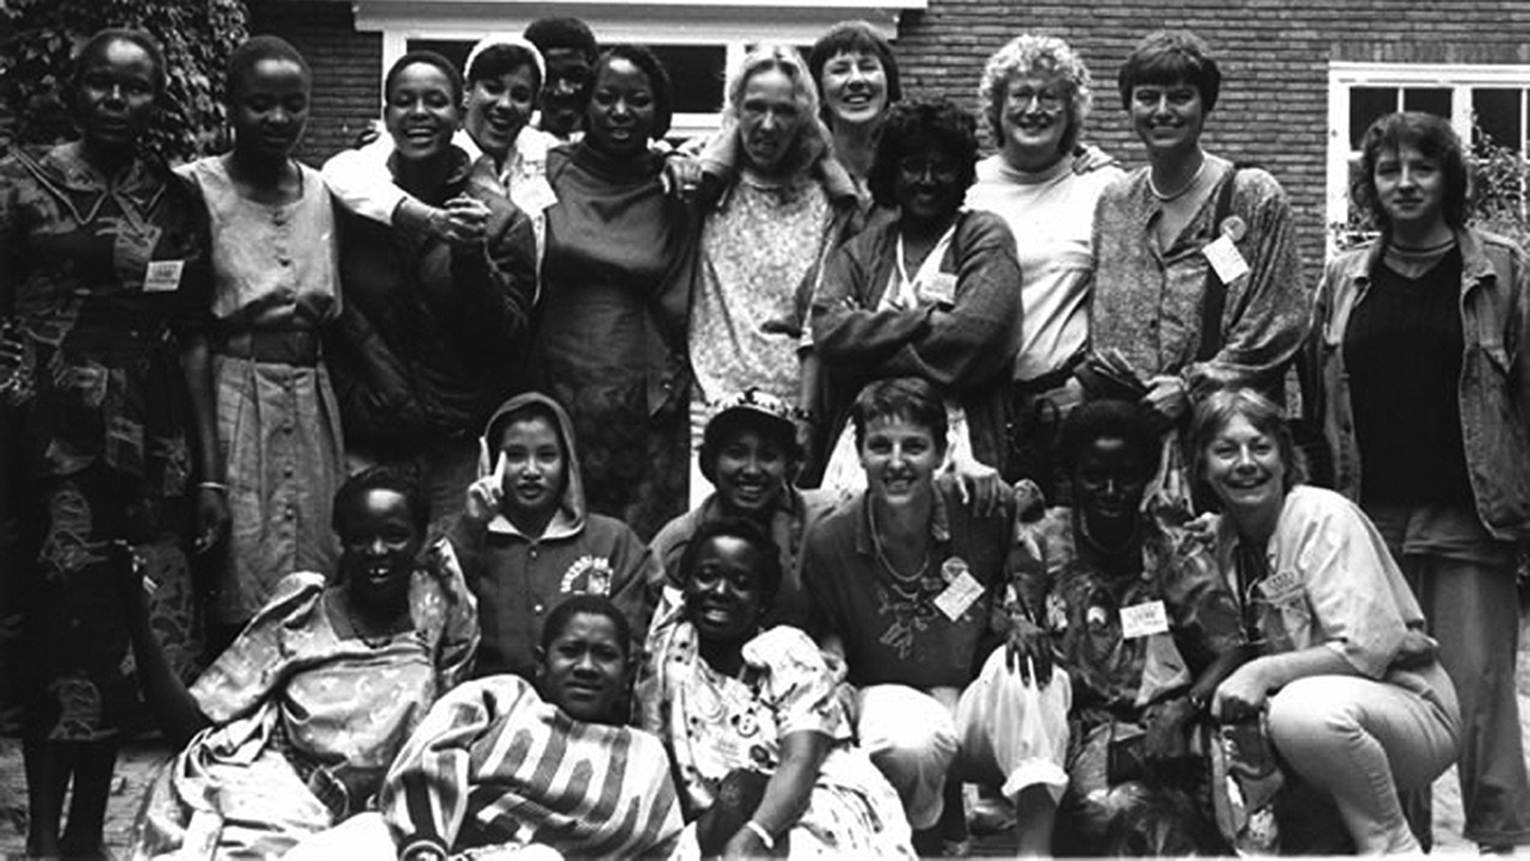
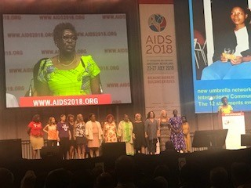
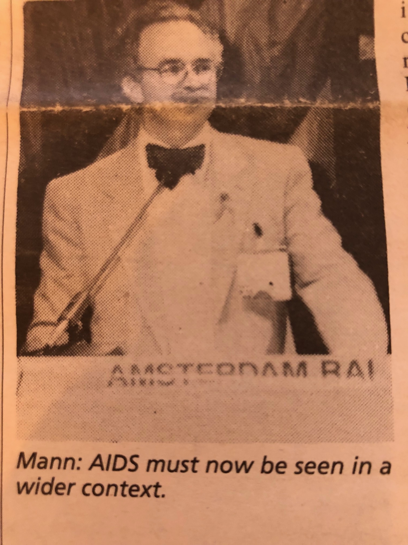
1992→2018
Source: ICW, Kate Thomson, and Robin Gorna

Slide 3
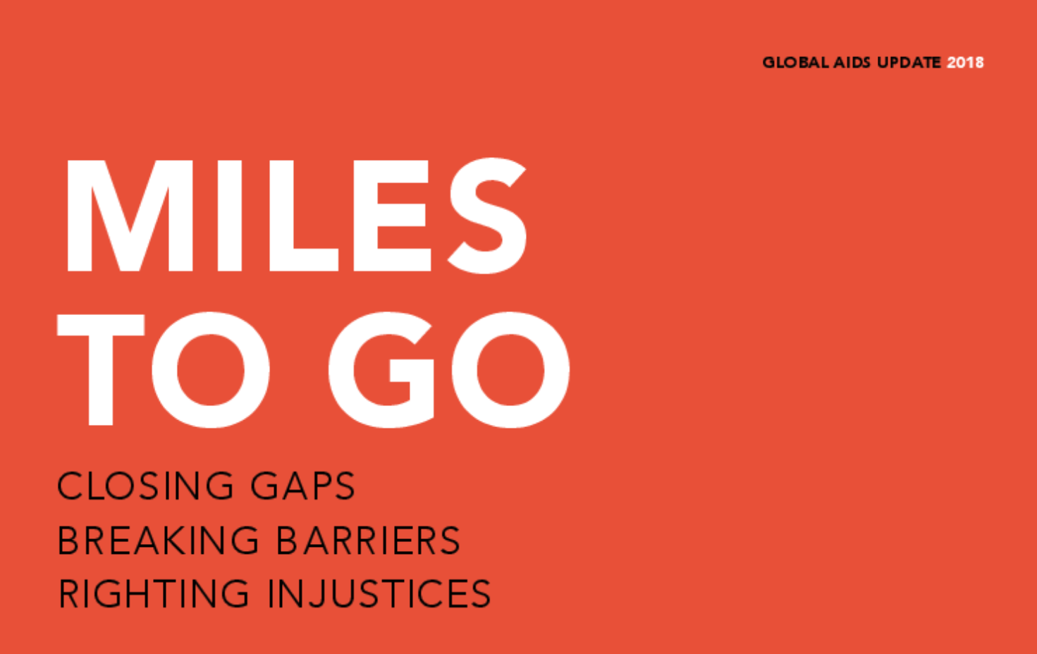
1. We are not on track to end the HIV pandemic, and the discourse on ending AIDS has bred a dangerous complacency

Slide 4
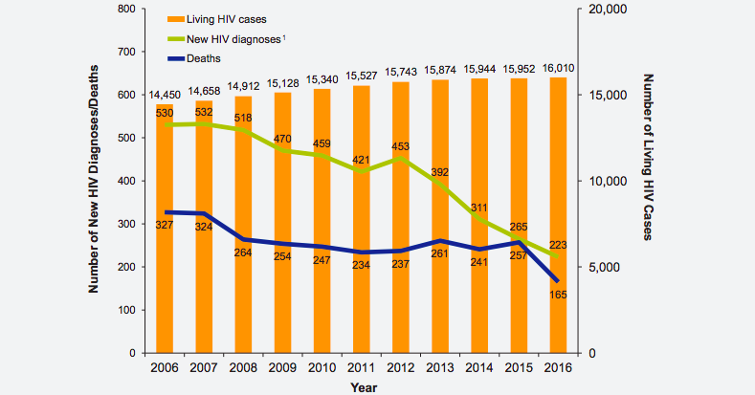
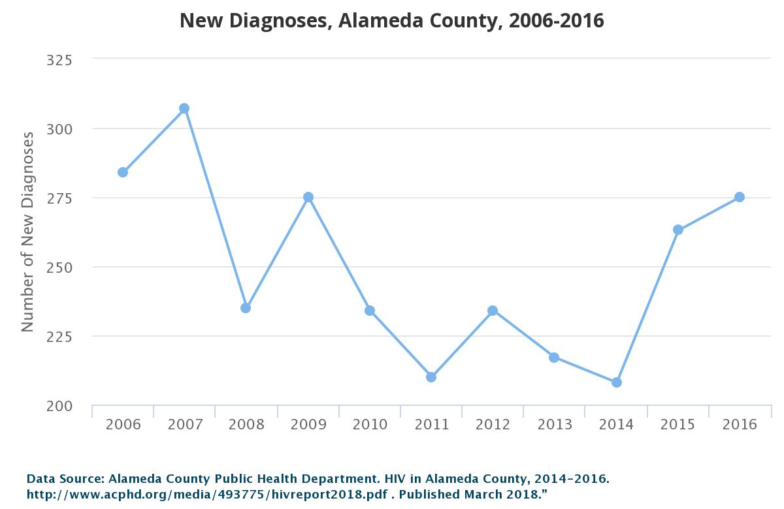
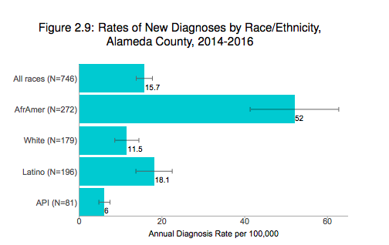
Sittin’ on the Dock of the Bay:
Oakland vs San Francisco
Source: San Francisco Department of Public Health
Source: Fast Track Cities and Alameda County Public Health Department
Notes:
https://www.sfdph.org/dph/files/reports/RptsHIVAIDS/Annual-Report-2016-20170831.pdf

Slide 5
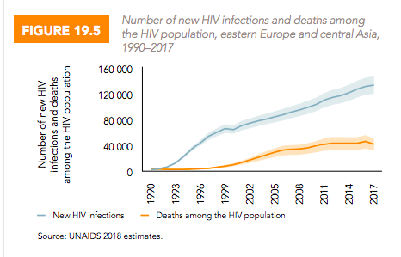
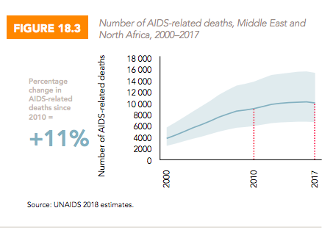
Out of control in eastern Europe and central Asia, new infections up by 29% (2010-2017)
Increases in deaths in the ART era! Aids-related deaths up by 11% (2000-2017) in Middle East and North Africa.
Source: UNAIDS 2018- ‘Miles to Go’

Slide 6

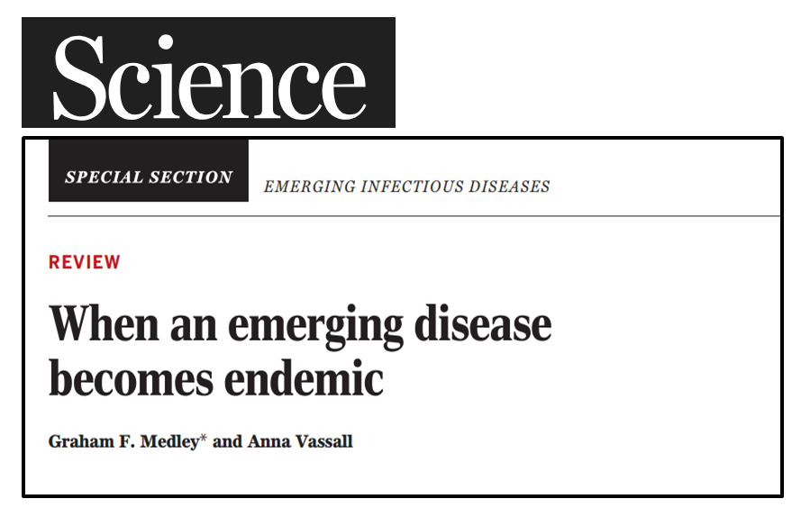

2. Existing HIV tools and strategies are insufficient

Slide 7
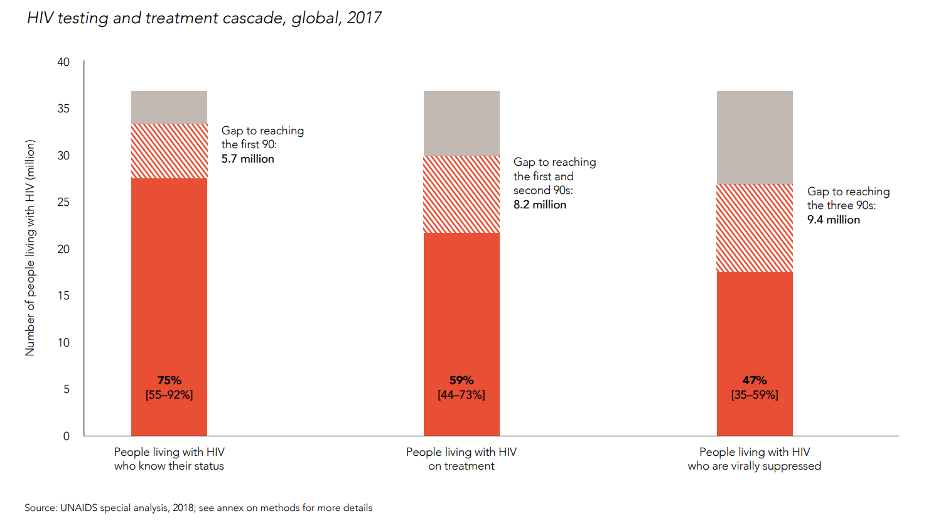
90-90-90 (90-81-73)
Source: UNAIDS 2018- ‘Miles to Go’
Notes:
http://www.unaids.org/sites/default/files/media_asset/miles-to-go_en.pdf

Slide 8
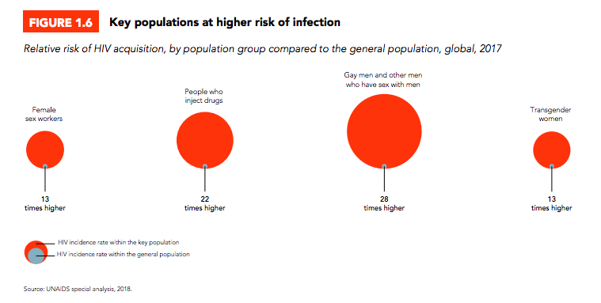
10-10-10 (10-19-27)
Existing approaches are leaving numerous populations behind
10-10-10 will determine the future of the epidemic
Source: UNAIDS 2018- ‘Miles to Go’

Slide 9
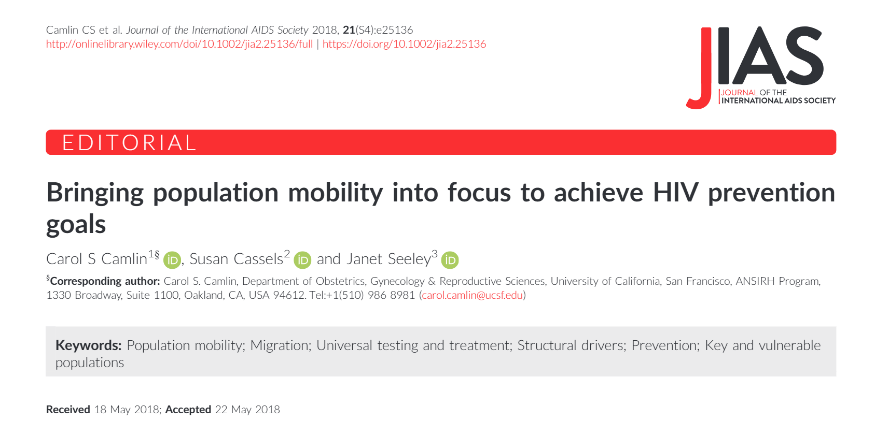
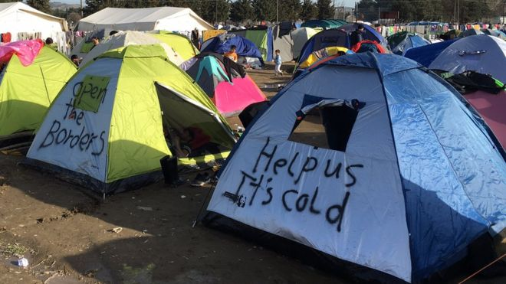
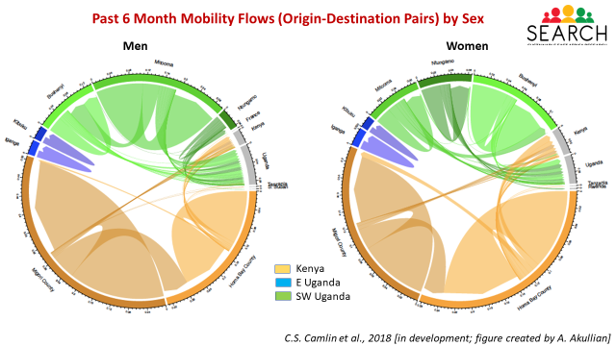
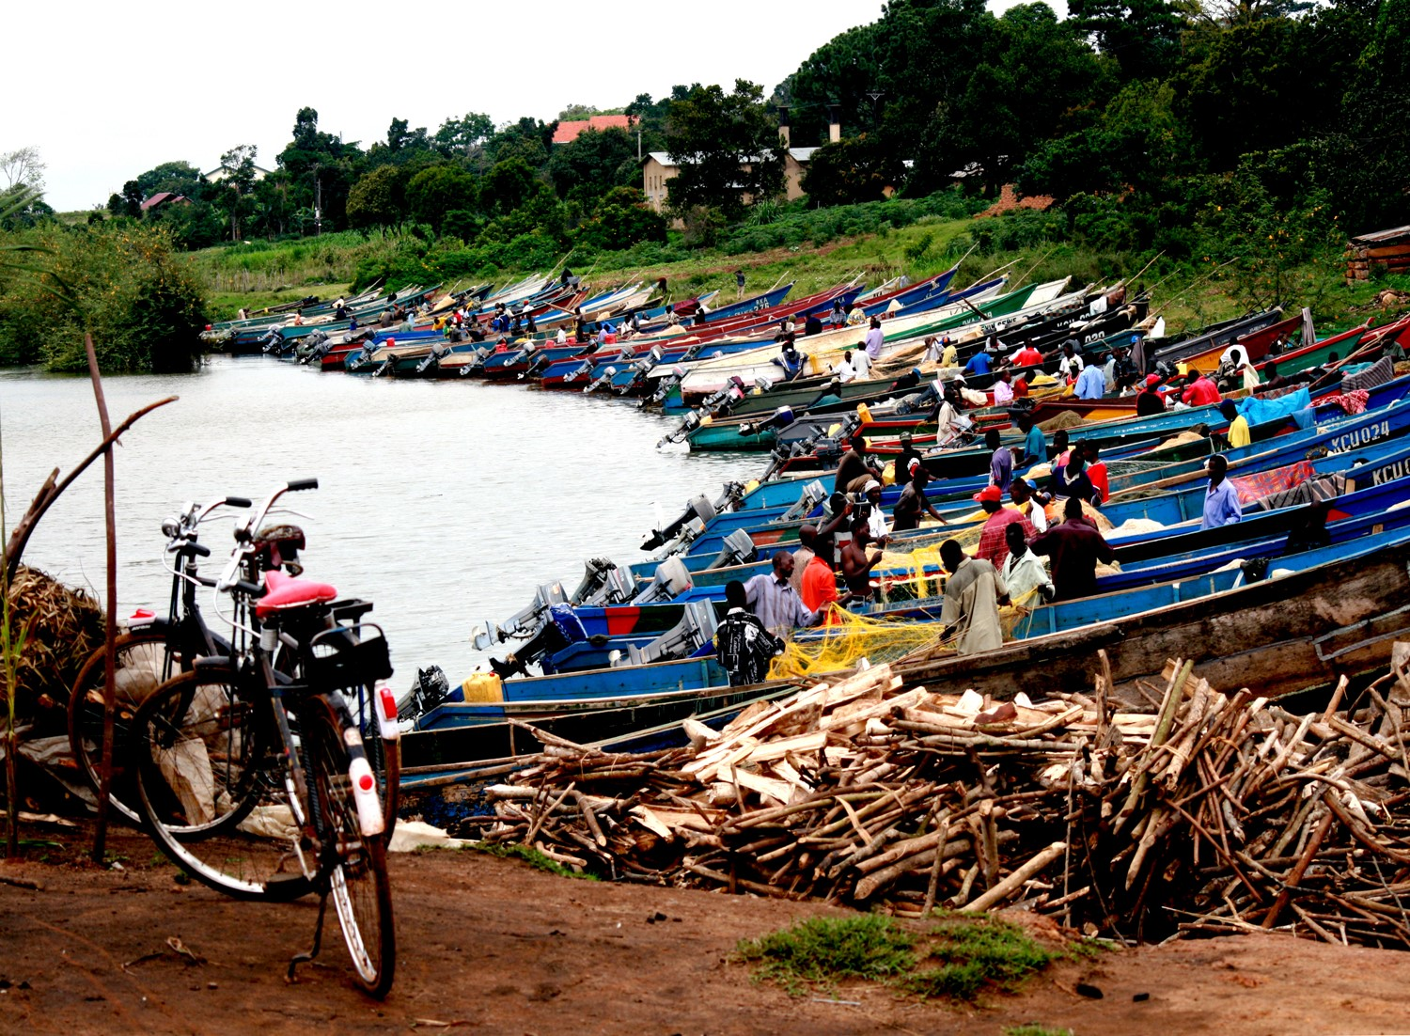
“The number of people living in a country other than the one in which they were born is larger than the population of all but four countries”
Greece (Source: Gavin Lee, BBC 2016)
Fishing site in Uganda
Notes:
This Figure shows Origin-destination pairs (categorized by country, and county/district geographic units) showing the magnitude of labor and non-labor-related (combined) trips requiring an overnight stay (sampling-weighted number of trips per person in a six-month time period).
Study “Understanding Mobility and Risk in SEARCH Communities” (PI Camlin, R01MH104132): embedded within the Sustainable East Africa Research in Community Health (SEARCH) trial (PI Havlir, NCT# 01864603)
Talking points:
Magnitude of mobility varies across regions and across genders
Not only migration (permanent changes of residence over geopolitical boundaries) matters for HIV research; ALSO, short term mobility (trips away from home) is associated with higher risks of HIV, and disruptions to HIV care engagement.
Interventions to improve the HIV prevention and care continue should account for movements of people in and out of communities, and address the needs of migrants (those who move residences over national and subnational boundaries) and highly mobile people (who travel for periods of time to and from households)

Slide 10
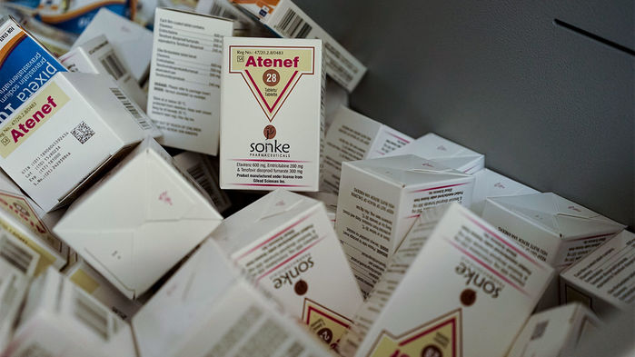
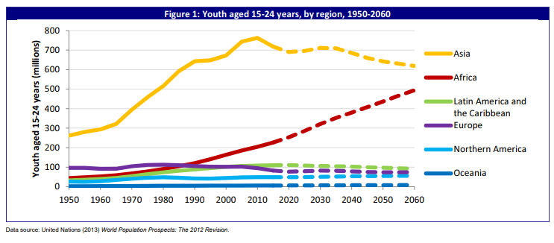
3. Tens of millions of people will require sustained access to ART for decades Need to prevent a resurgence of HIV
Source: UN DESA 2015
Notes:
Each day, there are around 4,400 new infections among adults aged 15 and older, 33% of these are among young people (15 to 24)

Slide 11
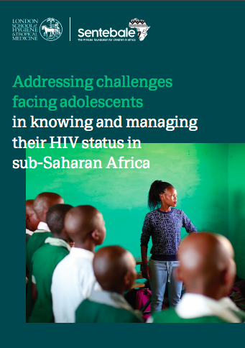
Adolescents: higher risks for girls, but community-based support effective for access to care
ZENITH TRIAL in Zimbabwe
Visits by trained community health workers
Significantly fewer participants with virological failure at 12 months post ART initiation in intervention group: 33% vs 49%
Ferrand et al, Lancet Child & Adolescent Health 2017:
Notes:
23 countries—the majority of which are in sub-Saharan Africa— that have among the highest numbers of new HIV infections in children, adolescents and young women

Slide 12

Projected AIDS spending needs by GDP,
2030 (Hecht et al, aids2031)
Notes:
12

Slide 13
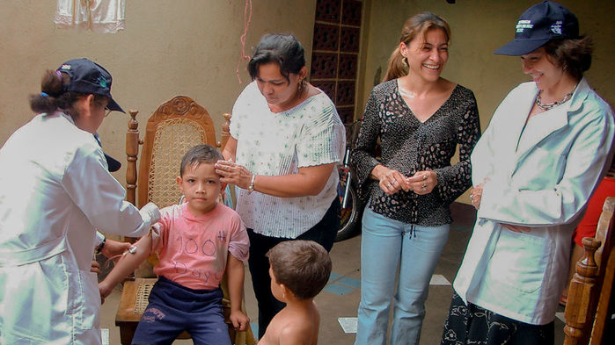
4.Allowing the pandemic to rebound could also diminish support for global health efforts

Slide 14
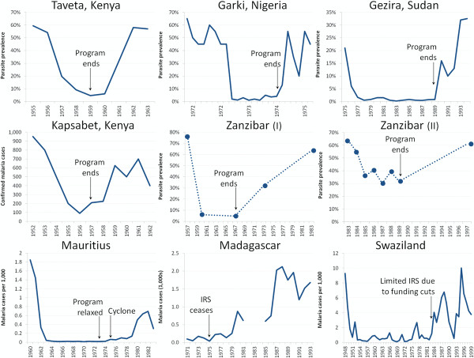
When the funding stops: Malaria rebound
(Cohen et al. Malar J 2012; 11:122)

Slide 15
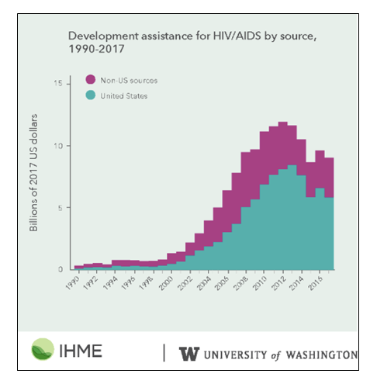
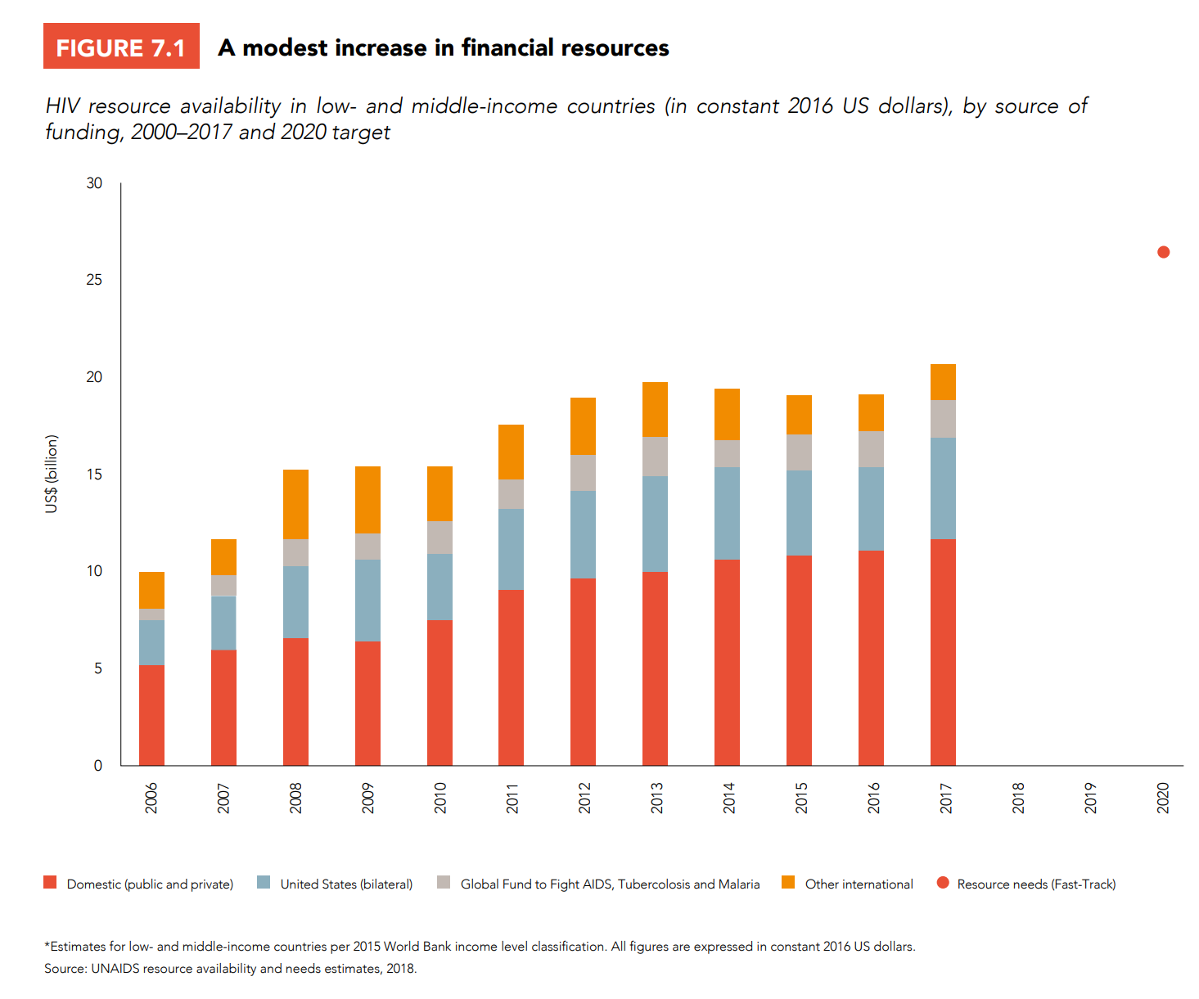
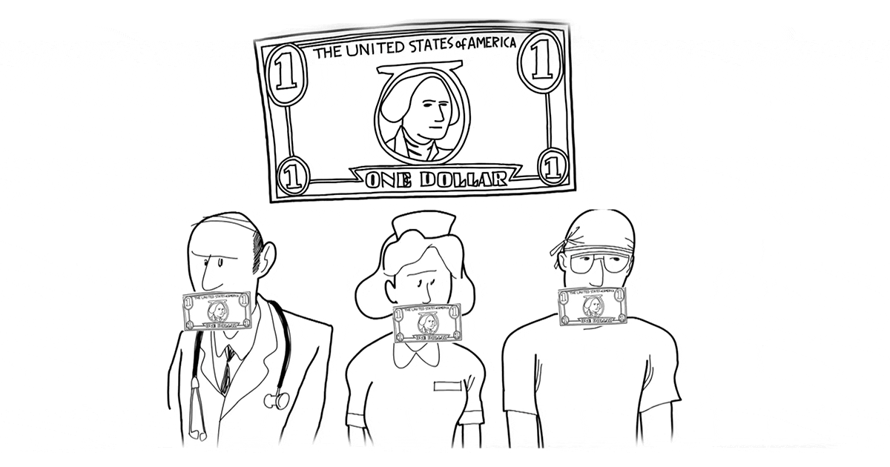

HIV Funding Under Threat
Source: UNAIDS 2018- ‘Miles to Go’
Source: IHME, University of Washington
Source: Planned Parenthood Action Fund
Source: SheDecides

Slide 16
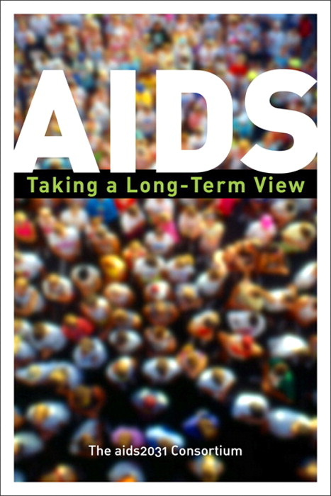
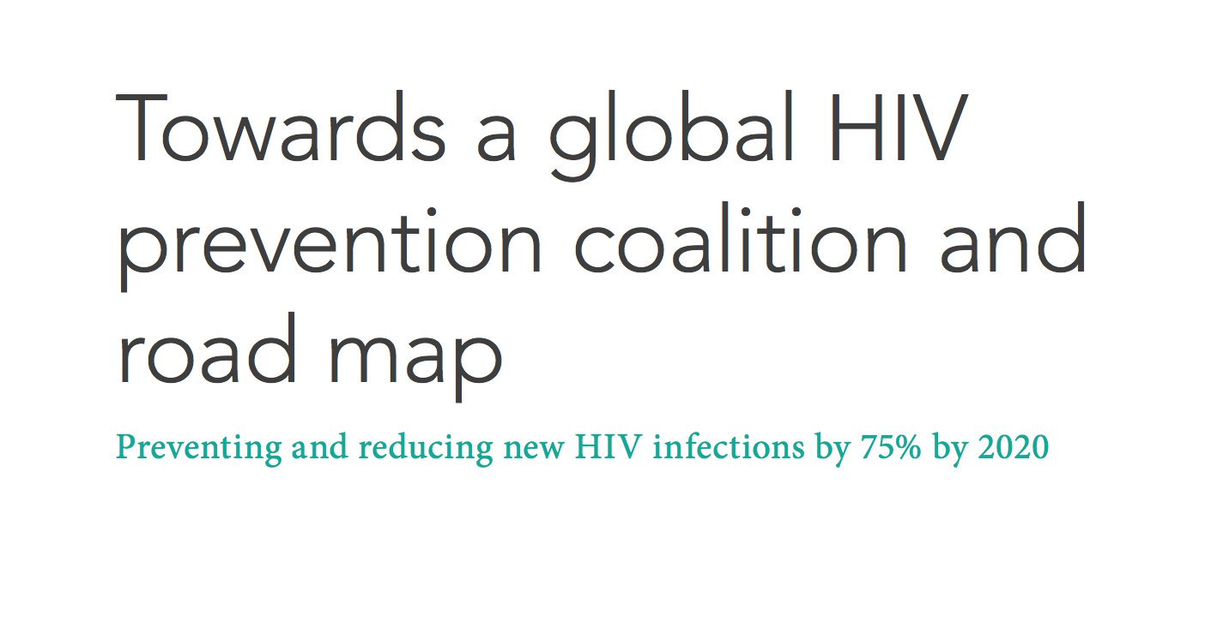
5. A rejuvenated effort on HIV is essential, and commitment to ART must be matched by expanding HIV prevention.
Source: UNAIDS 2018

Slide 17
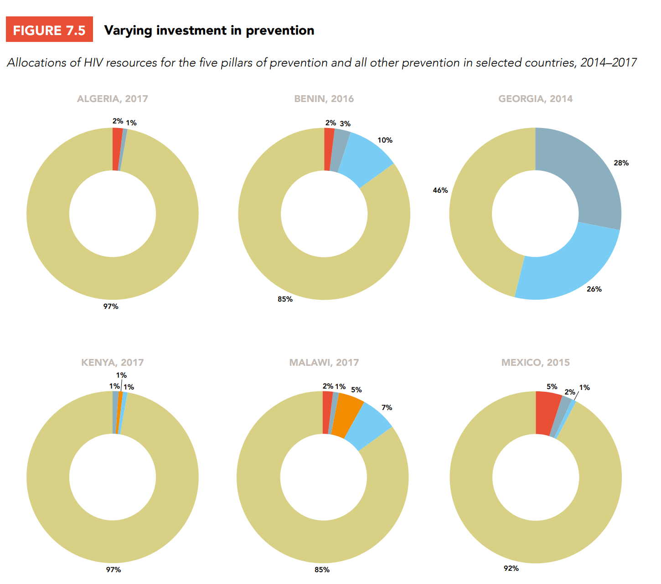
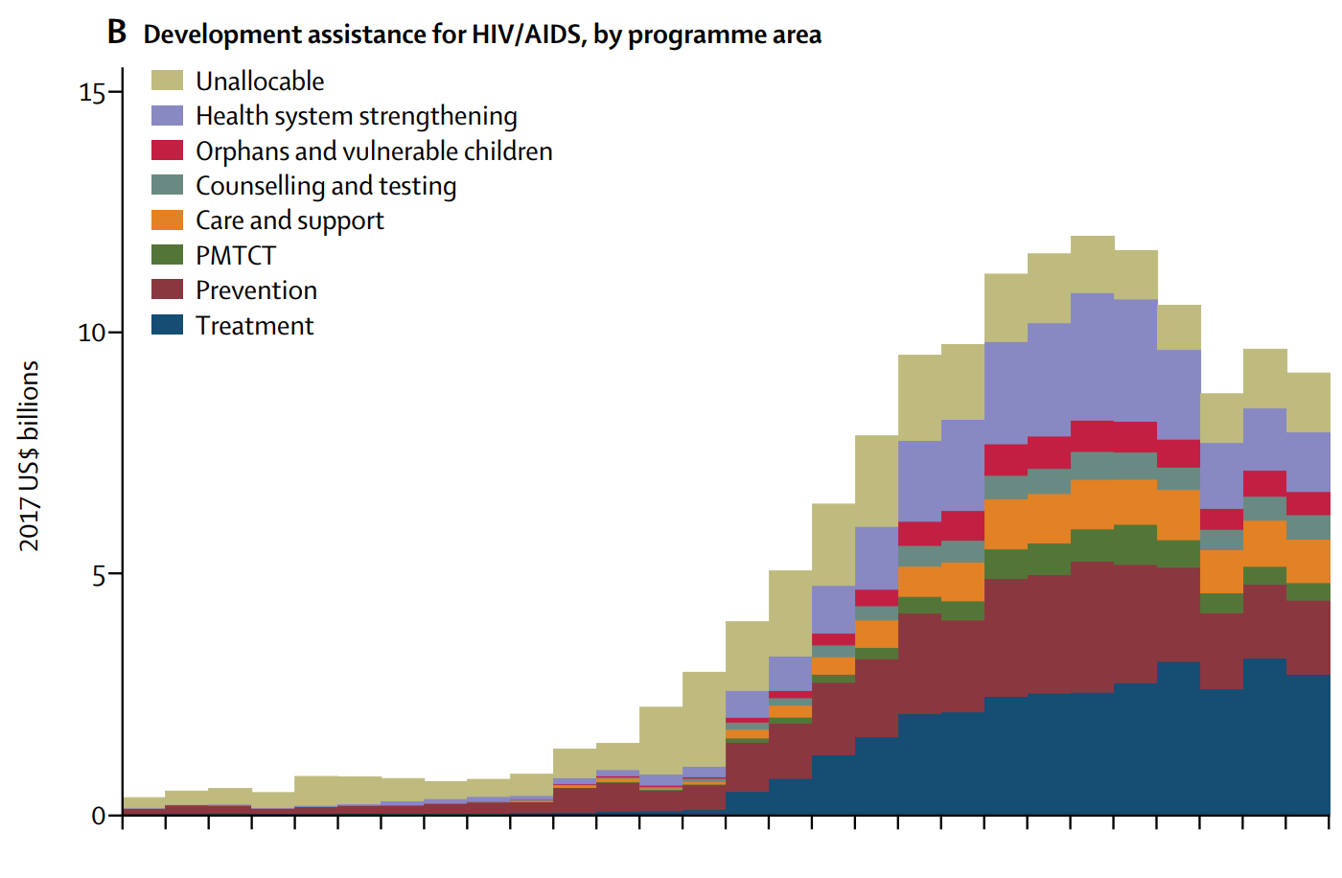
Need to step up funding for prevention!
Source: Global Burden of Disease Health Financing Collaborator Network
Dieleman, Joseph L., et al. "Spending on health and HIV/AIDS: domestic health spending and development assistance in 188 countries, 1995–2015." The Lancet391.10132 (2018): 1799-1829.
Source: UNAIDS 2018- ‘Miles to Go’
Notes:
Dieleman, Joseph L., et al. "Spending on health and HIV/AIDS: domestic health spending and development assistance in 188 countries, 1995–2015." The Lancet391.10132 (2018): 1799-1829.

Slide 18
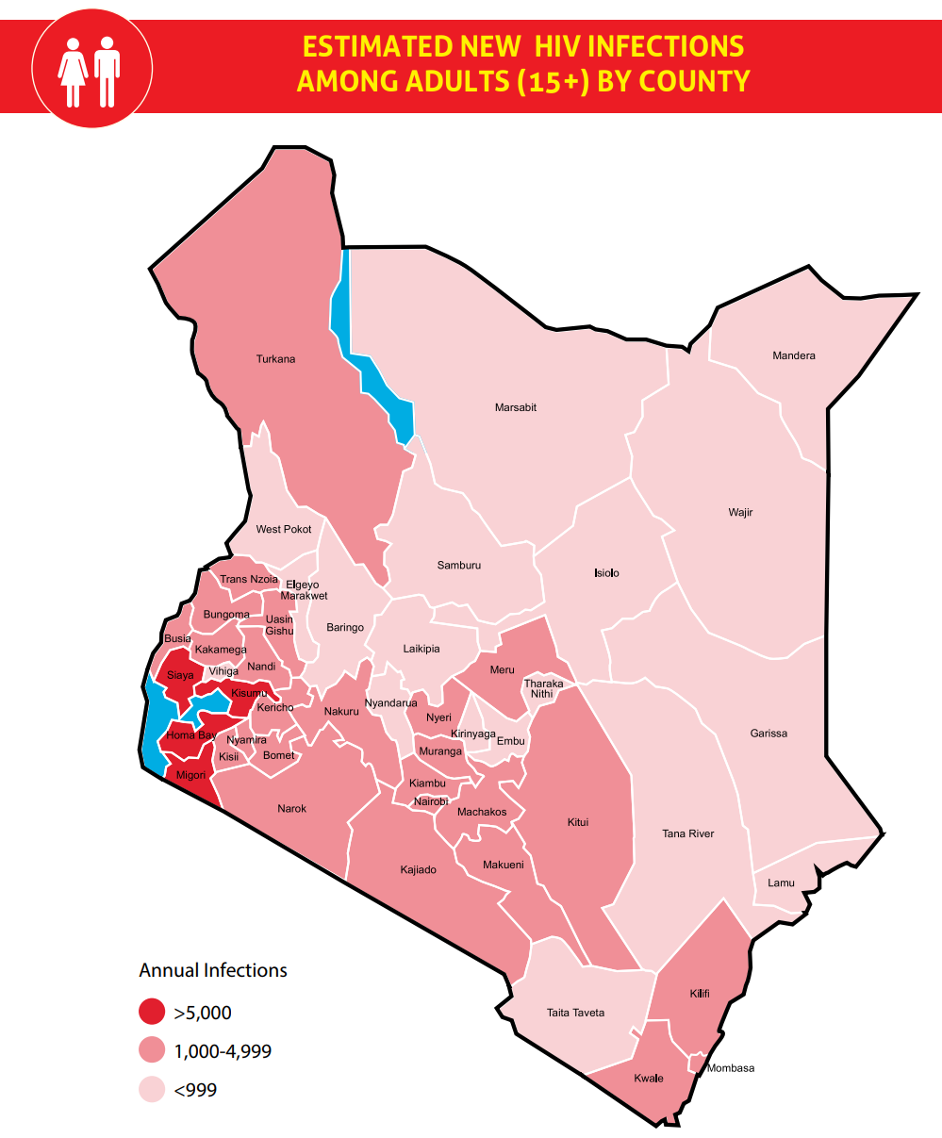
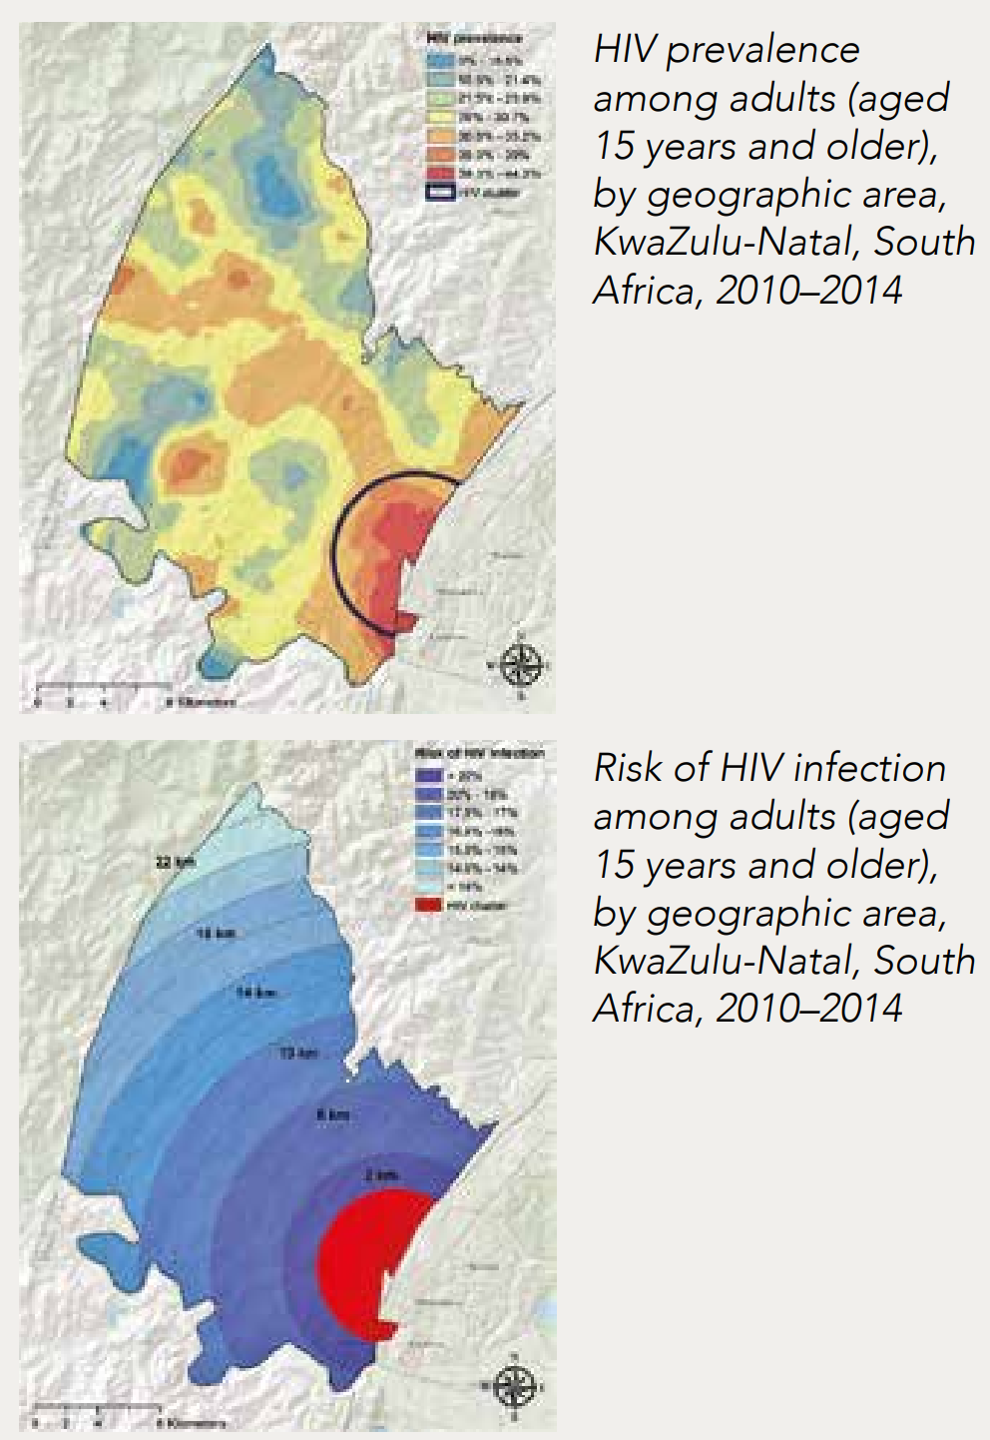
Precise data allowing precision prevention
Kenya
KwaZulu-Natal, South Africa
Kenya
Kwa-Zulu Natal, South Africa
Source: Cuadros DF. Assessing the role of geographical HIV hot-spots in the spread of the epidemic (CROI 2018) cited by UNAIDS 2018 (Miles to Go)
Source: National AIDS Council (NACC). Kenya HIV County Profiles 2016

Slide 19
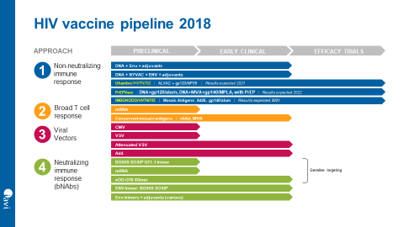


A vaccine is essential to ending HIV
No infectious disease has been eliminated without a vaccine.
Even a partially effective vaccine
would make a major difference.
- 45%
- 67%
2M
1M
10 Years
25
Years
0M
Without vaccine
With vaccine
With vaccine
Reduction in mortality
Source: International AIDS Vaccine Initiative

Slide 20
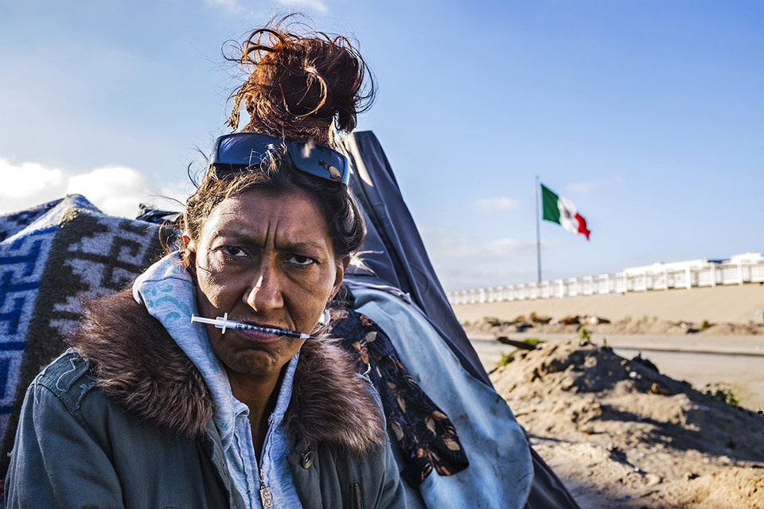
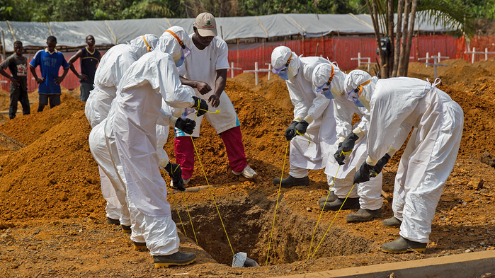
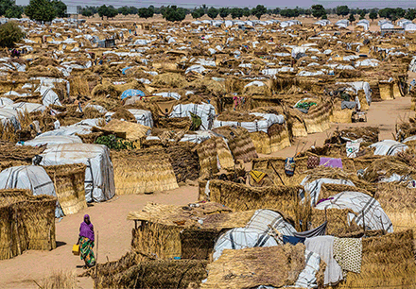
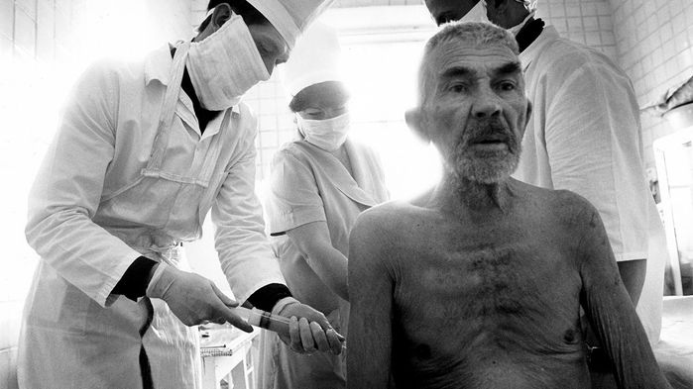
6. HIV response must make common cause with broader global health

Slide 21
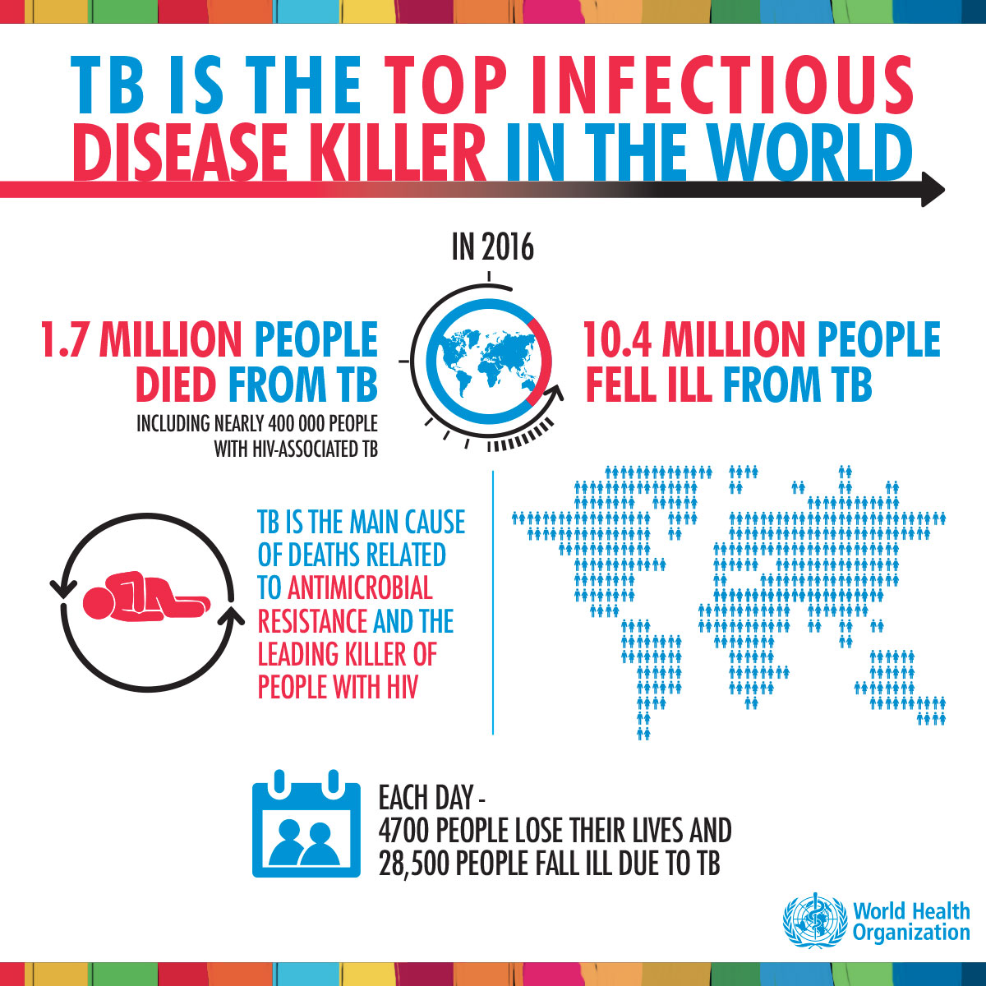
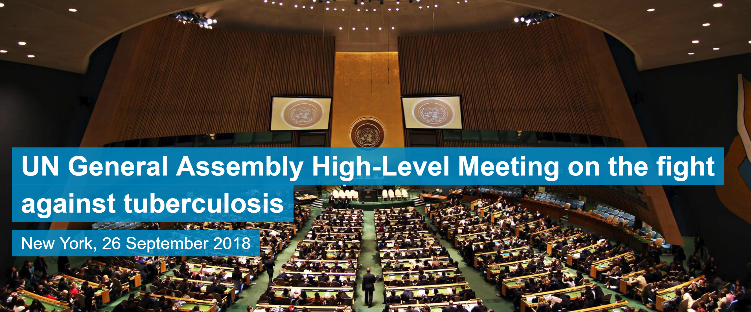
HIV/TB: too many lives lost
UN High-Level Meeting-Opportunity not to be missed
Source: WHO 2018

Slide 22
A more integrated HIV response can offer ‘win-win’ results for both HIV and non-HIV health outcomes

Slide 23
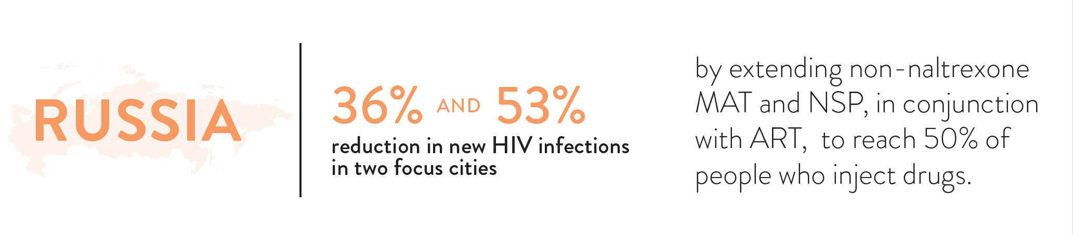
HIV cases and opioid overdoses averted in two Russian cities in 10 years
White boxes: Omsk
Grey boxes: Ekaterinburg
53%
48%
36%
36%
36%
HIV cases averted among PWID, 2018-2028 (%)
33%
23%
21%
17%
10%
(Thanks to Javier Cepeda, Natasha Martin & Peter Vickerman)
NSP
(50%)
MAT
(25%)
MAT
(50%)
NSP+ MAT
(50%)
NSP + MAT (50%)
Integrated ART(recruit 3X base case per yr)
1. Bekker LG, Baral SD, Cepeda J, et al. Advancing global health and strengthening the HIV response in the era of the Sustainable Development Goals: the International AIDS Society—Lancet Commission. Lancet 2018; published online July 19.
2. Cepeda JA, et al. Potential impact of implementing and scaling up harm reduction and antiretroviral therapy on HIV and overdose deaths among people who inject drugs in two Russian cities: a modelling study. Lancet HIV. In Press.

Slide 24
Impact of HIV & reproductive health integration in Nigeria
(Thanks to Parastu Kasaie)
Notes:
METHODS
Model: Spectrum’s demproj, AIM/GOALs, and FamPlan modules
Baseline: Maintaining fixed PMTCT (26%) and contraceptive (15%) coverage over the next decade (2018 – 2028)
Interventions
Family planning: Increasing contraceptive coverage to 31% by 2023 and maintaining through 2028
PMTCT: Increasing PMTCT option B+ coverage to 90% (UNIAIDS & PEPFAR targets) by 2023 and maintaining through 2028
Outcomes: Reduction in HIV incidence, HIV diagnosis in infants, unwanted pregnancies and maternal and infant morbidity and mortality

Slide 25
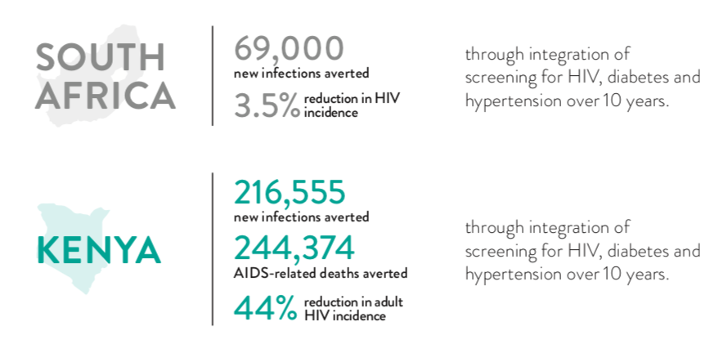
Engagement in care in South Africa
(Thanks to Leigh Johnson)

Slide 26
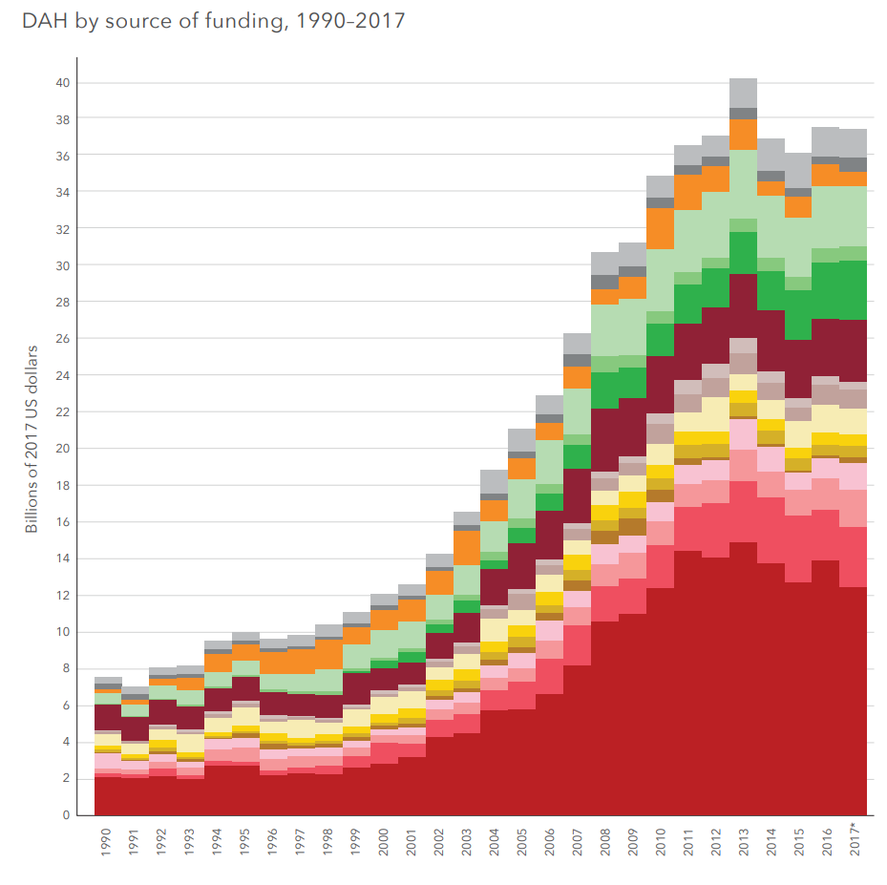

Co-financing across sectors could prevent the undervaluation of structural interventions
Declines in development assistance for health
Source: IHME, Financing Global Health 2017
_
SOURCE: Institute for Health Metrics and Evaluation (IHME). Financing Global Health 2017

Slide 27
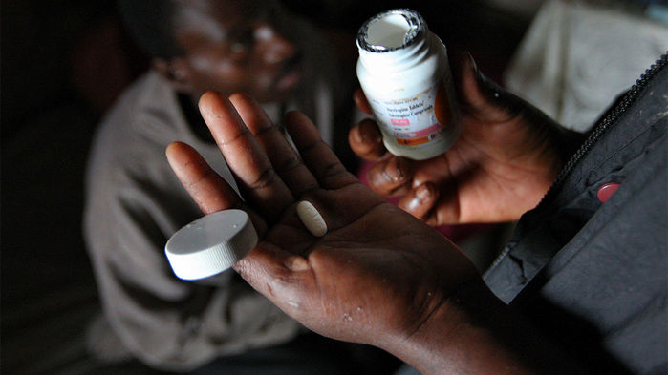
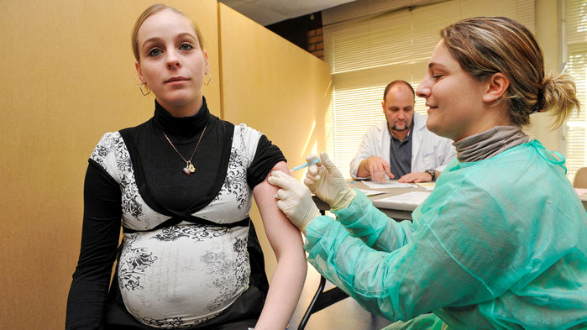
7. New era of global health solidarity should focus on people-centred health systems

Slide 28



Beyond UHC and health sector!
MTV SHUGA in Nigeria
MTV Shuga is a 360-degree mass media campaign, that uses the power of entertainment to affect positive change in young people’s lives.
* Young women who watched MTV Shuga:
Demonstrate a 55% reduction in STDs (Biomarker: Chlamydia).
Choose fewer and safer partners.
Viewers were 2 X more likely to get tested for HIV 6 months after watching the show.
Source: World Bank Study

Slide 29
Violence and harmful gender norms undermine 90-90-90
HIV testing
IPV was associated with inability to access care and treatment.
Viral load suppression
IPV reduced odds of women adhering to ART by half.
Partner abuse associated with poor adherence leading to poor clinical outcomes (CD4+, VL).
Increased loss to follow up
Gender inequality undermines women's decision-making autonomy about HIV testing
IPV associated with treatment discontinuation
IPV was associated with lower current ART use among women
Women were reluctant to, or did not include, their male partners in PMTCT services due to fear of violence.
Fear of IPV prevented some women from accessing testing (variable results). One study suggested that IPV motivates HIV testing.
Fear of violence prevented disclosure
ART initiation
Source: Kouyoumdjian, 2013; Morfaw, 2013; Musheke, 2013; Pantalone, 2014; Hatcher, 2015;

Slide 30
Violence is preventable
Study | Intervention | Intervention | Outcome | Impact on pat year experiences of physical or sexual violence
SASA! trial Kampala, Uganda | Community mobilization using clear theory of change | Community mobilization using clear theory of change | Womens past year experience of physical violence from partner | 52% reduction Impact at community level
IMAGE trial Limpopo, South Africa | 10 session participatory training added to micro-finance intervention | 10 session participatory training added to micro-finance intervention | Physical or sexual violence in past year | 55% reduction among participants
SHARE trial Uganda | RCT of modified SASA! intervention and brief intervention integrated into HIV testing | RCT of SASA! intervention with brief intervention as part of HIV testing | Physical partner violence Sexual violence | 20 % reduction physical violence; 18% reduction isexual violence
Stepping Stones RCT South Africa | Participatory reflection programmes with young women and men | RCT of group reflection and community activism | Physical or sexual violence perpetration | 27% reduction in 12 month perpetration of sexual and/ or physical violence by men
ECONOMIC EMPOWERMENT
WINGS Uganda |  | BRAC – cash transfers and microfinance training | IPV

Slide 31
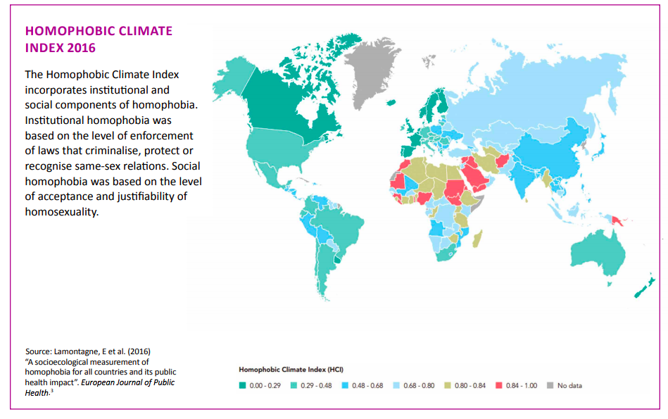
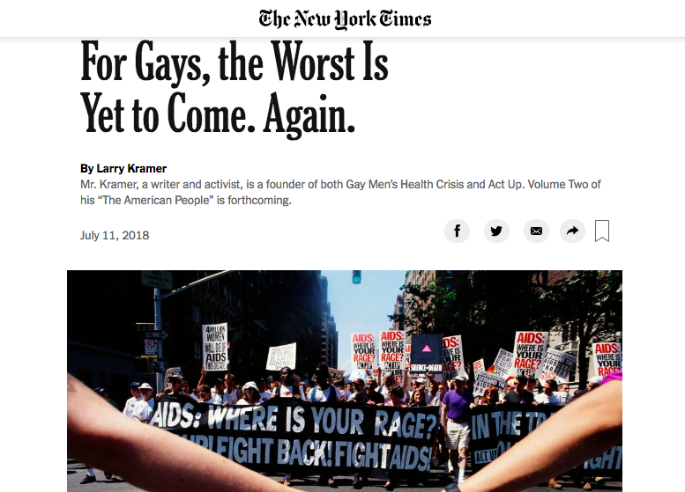
Source: STOPAIDS Sexual orientation, gender identity and HIV Fact Sheet

Slide 32
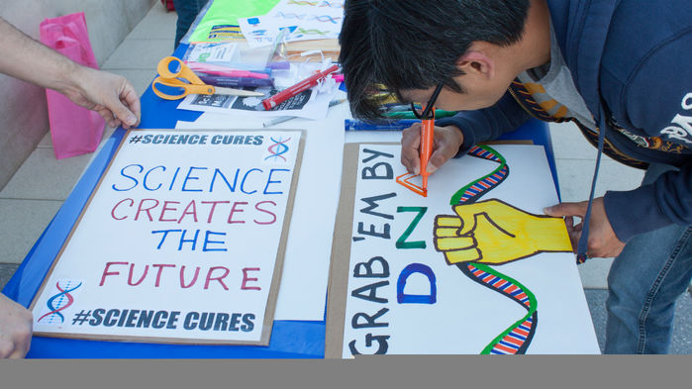
IAS/Lancet’s Future Agenda
Immediately rejuvenate HIV response: ensure 90-90-90 (10-10-10), primary prevention, vaccine R&D
Deliver on HIV funding commitments: Global Fund and PEPFAR, domestic funding.
Carefully and strategically integrate HIV within primary care and global health, with scale and pace geared to context and needs of people most in need of HIV services
Make common cause with global health to achieve sustainable health for all
Commission action plan: comments welcome!

Slide 33
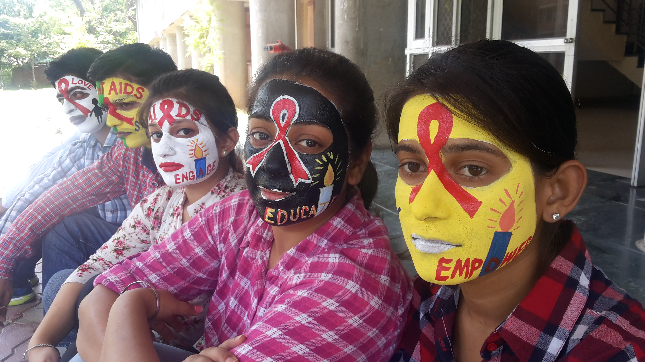
WHAT WE CAN’T LOSE
Human rights & commitment to social justice
Science & galvanisation of innovation
People-centred services & programmes
Activism and a strong diverse movement
Multidisciplinary & multi-sectoral action
Adequate funding
Leadership
Passion!

Slide 34

Thank you
Julia Spencer, Georgia Arnold, Tara Beattie, Chris Beyrer, Carol Camlin, Jon Cohen, Sarah Curran, Mark Dybul, Mark Feinberg, Rashida Ferrand, Mitzy Gafos, Linda Gail-Bekker, Alison Galvani, Robin Gorna, Bar Hariely, Richard Hayes, Emily Hyle, Mike Isbell, Nduku Kilonzo, Tammy Lall, Heidi Larson, Edmond Ng, Carey Pike, Janet Seeley, Kate Thomson, Sephy Valuks, Mitchell Warren, Charlotte Watts & Helen Weiss.

